Slide 1

Original

Slide 2

Regular step = 2 (3x3 mean initialization)

Slide 3
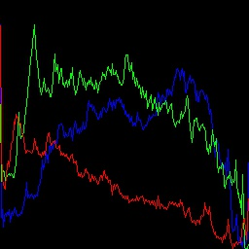

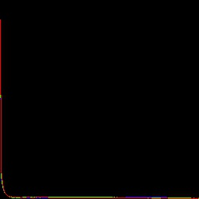
Regular step = 2 (3x3 mean initialization)

Slide 4
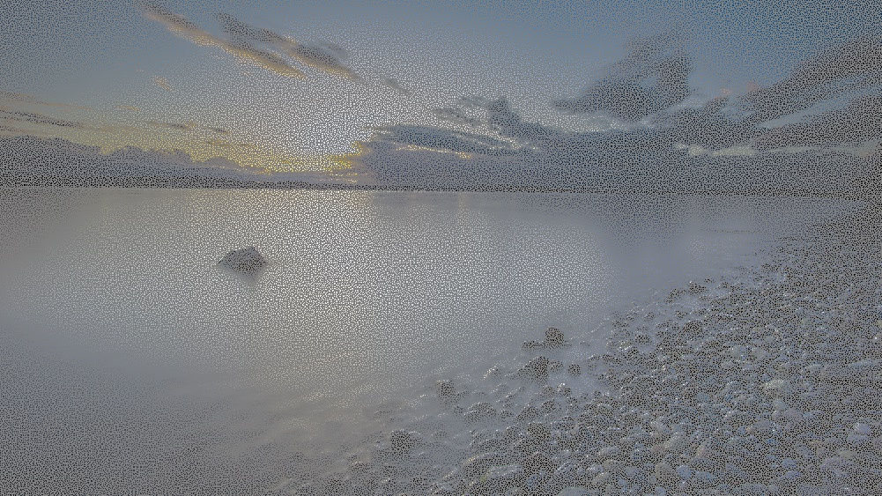
Rand in Square (mid gray) 1@2x2

Slide 5

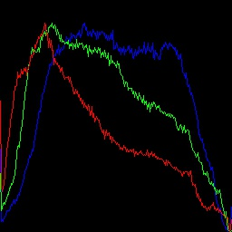
Rand in Square (mid gray) 1@2x2

Slide 6

Rand in Square (mean 5x5) 1@2x2

Slide 7

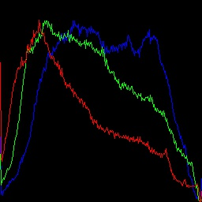
Rand in Square (mean 5x5) 1@2x2

Slide 8

Super Resolution 2x

Slide 9


Slide 10
